Slide 1

MENU
Detailed views will include descriptions and links for further prototyping
*Clickable links denoted by arrow emoticon (←, →, ↑, ↓)*
No arrow = no clickable link
Slide 2 | Desktop homepage view
Slide 3 | Detailed desktop homepage view
Slide 4 | ‘Rufus’ + ‘Shop by Department’ + ‘Search’ view
Slide 5 | Detailed ‘Rufus’ + ‘Shop by Department’ + ‘Search’ view
Slide 6 | ‘Shop by Department’ view
Slide 7 | Mobile homepage view
Slide 8 | Amazon settings view
Slide 9 | Amazon help view
Slide 10 | Amazon ‘Explore more’ view
Slide 11 | Amazon “Sports & Outdoors” view

Slide 2
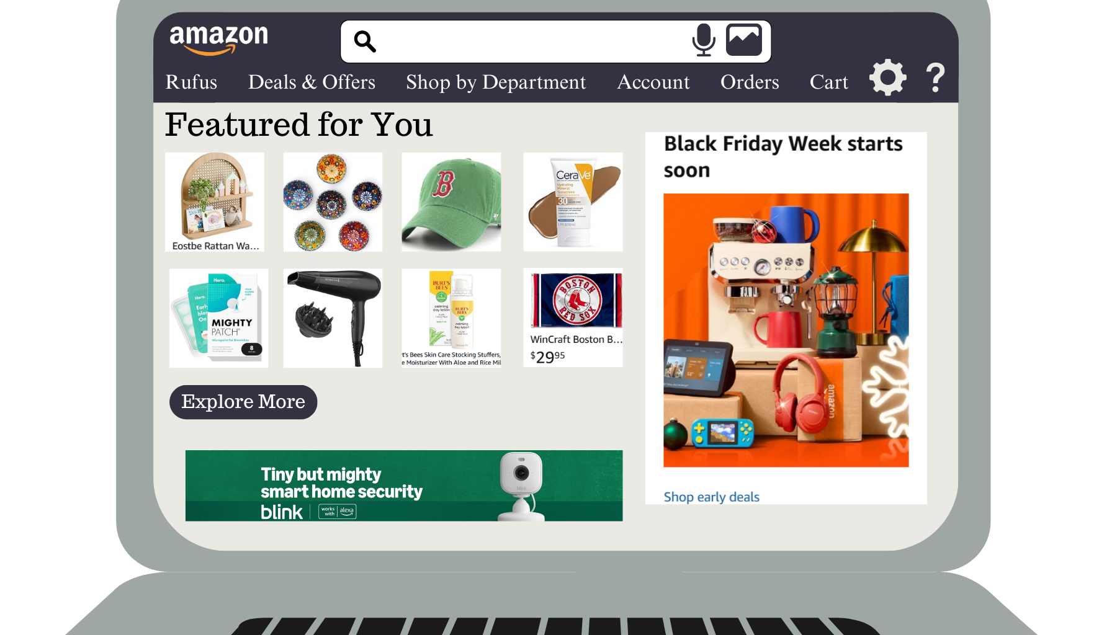
CLICK HERE TO RETURN TO MAIN MENU

Slide 3
To return to homepage →
← Expanded view
Settings ↓
Expanded view →
← Help page
Expanded view ↑
← Explore more products
Ads
CLICK HERE TO RETURN TO MAIN MENU

Slide 4
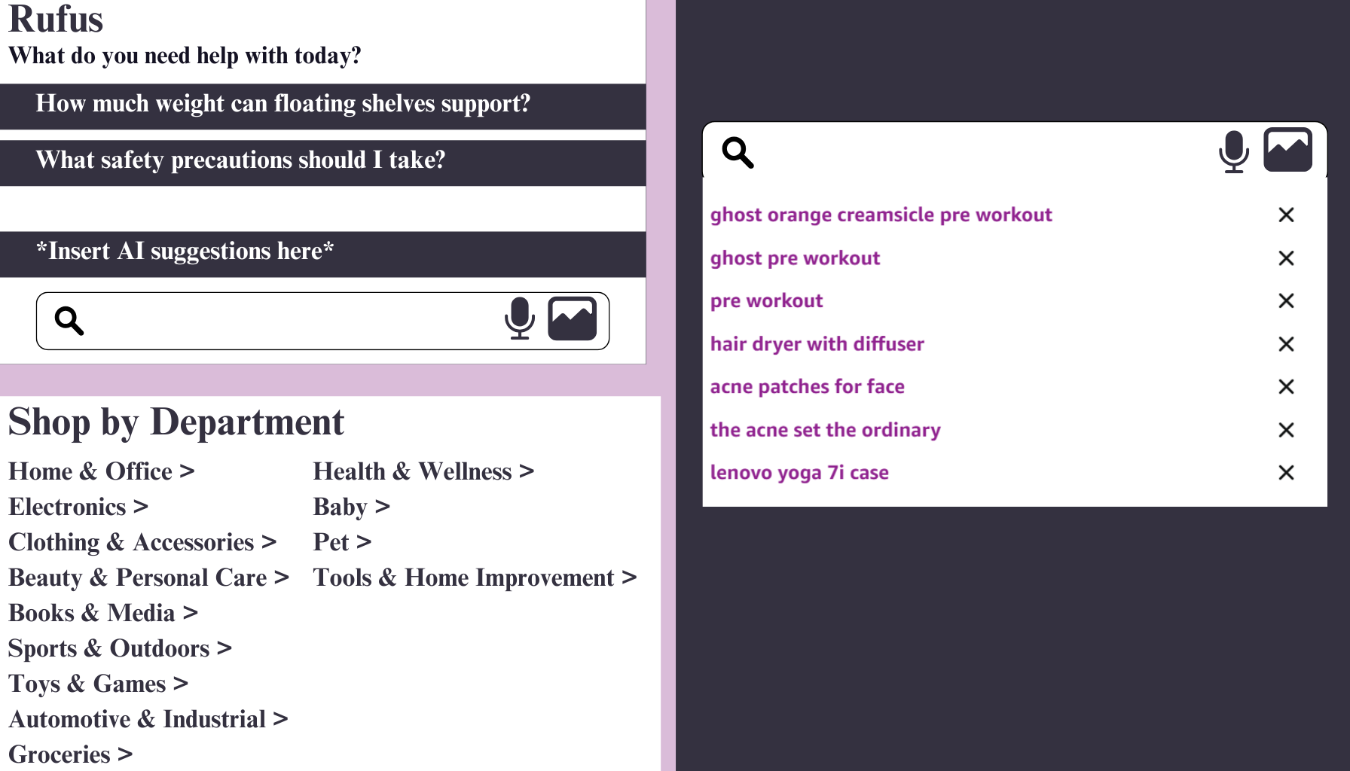
CLICK HERE TO RETURN TO MAIN MENU

Slide 5
Upload photo
functionality
Voice search
functionality
Automatic AI suggestions based on previous browsing history
Voice search
functionality
Upload photo
functionality
← Expanded view
Designed to be a drop-down menu upon hovering over “Shop by Department” in navigation menu
CLICK HERE TO RETURN TO MAIN MENU

Slide 6
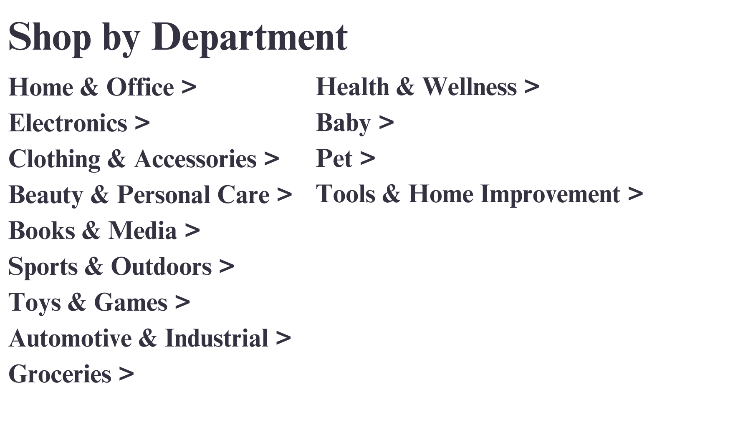
← “Sports & Outdoors” Amazon page
CLICK HERE TO RETURN TO MAIN MENU

Slide 7
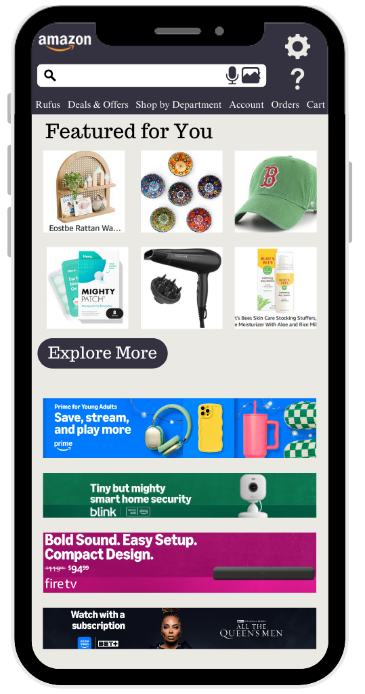
CLICK HERE TO RETURN TO MAIN MENU

Slide 8
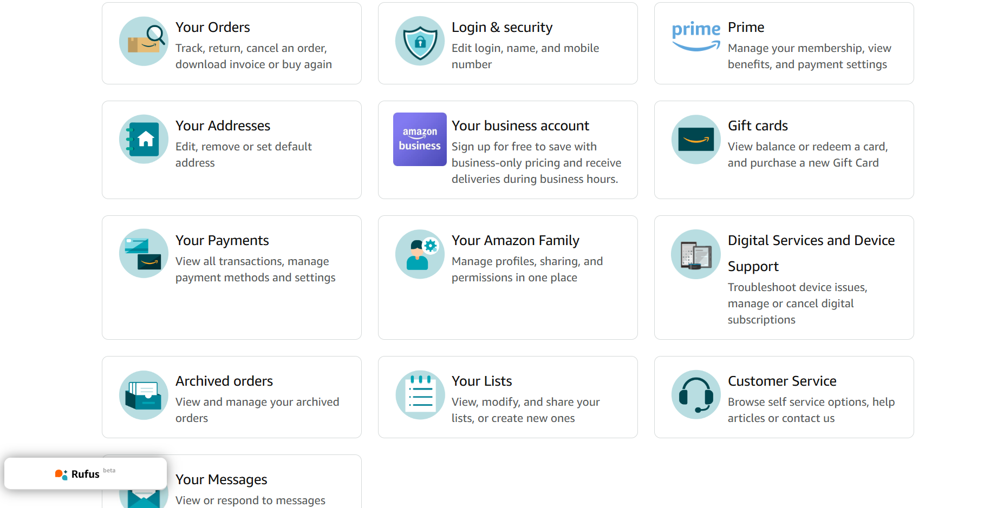
CLICK HERE TO RETURN TO MAIN MENU
*Screenshot taken from amazon.com*

Slide 9
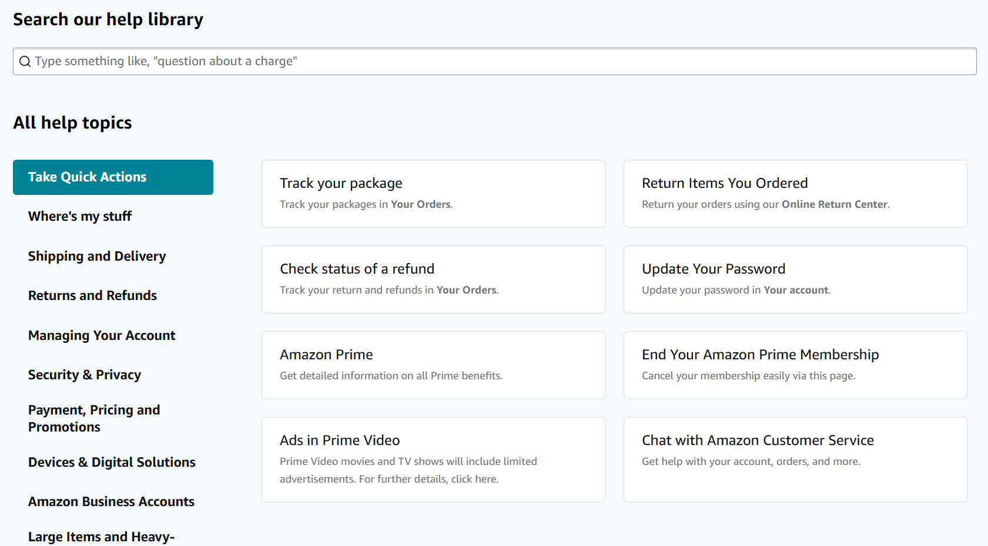
*Screenshot taken from amazon.com*
CLICK HERE TO RETURN TO MAIN MENU

Slide 10
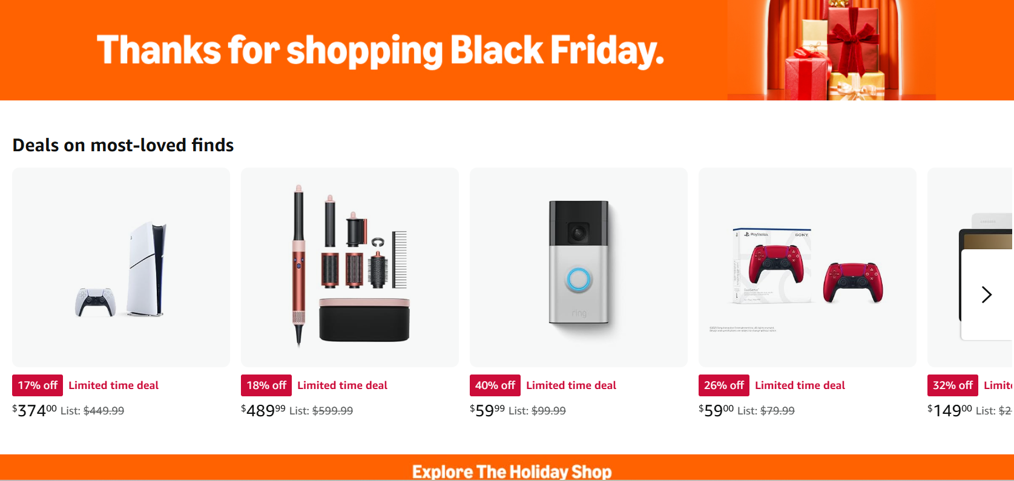
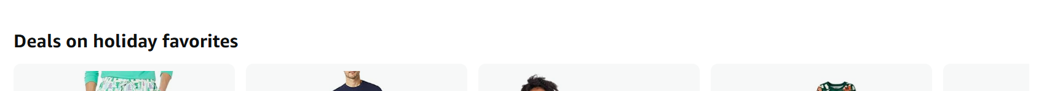
*Screenshot taken from amazon.com*
CLICK HERE TO RETURN TO MAIN MENU

Slide 11
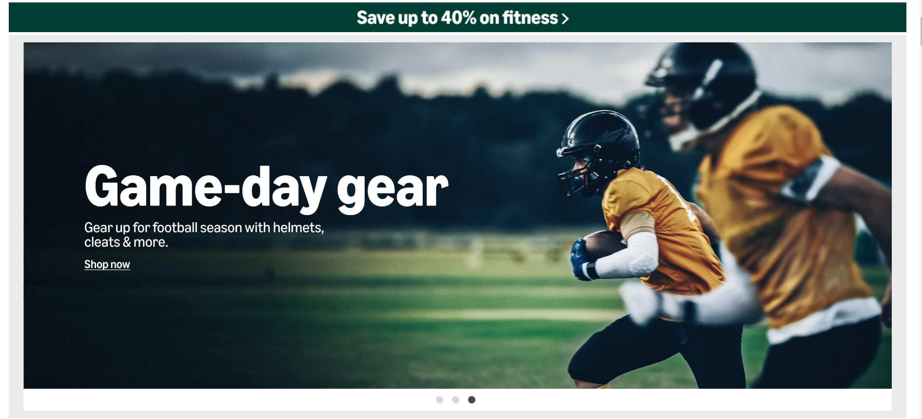
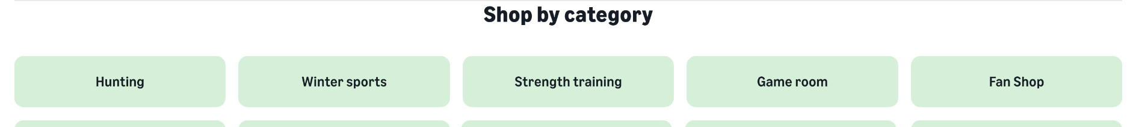
CLICK HERE TO RETURN TO MAIN MENU
*Screenshot taken from amazon.com*

